Slide 1
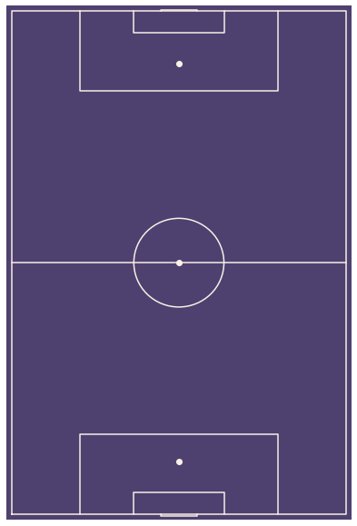
Player receipt position captured by model
Path of previous pass captured by model
Teammate position not captured by model
Opponent position not captured by model
Opponent GK position not captured by model
Training Sample A
Goal in next 5 actions = 0
Training Sample B
Goal in next 5 actions = 1
Training Sample C
Goal in next 5 actions = 0

Slide 2
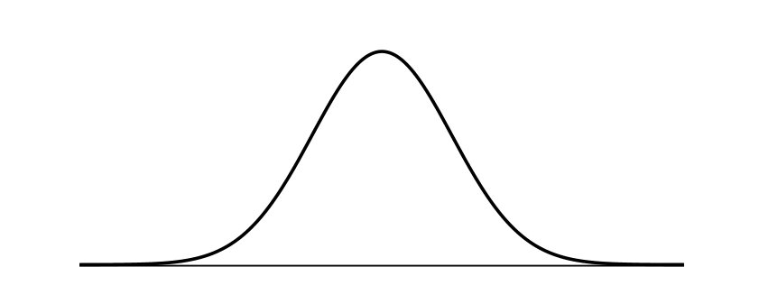
Single Point Prediction
Probability Distribution Prediction
We have no information about the range of possible values the true value could be
We have a full distribution of possible values the true value could be
Action Value = fX (x)
Action Value = 0.02
-0.10
0.00
0.10
-0.10
0.00
0.10

